Slide 1
Impact of COVID-19 in Idaho Public Health District 3
James Gallyer, Ph.D.

Slide 2
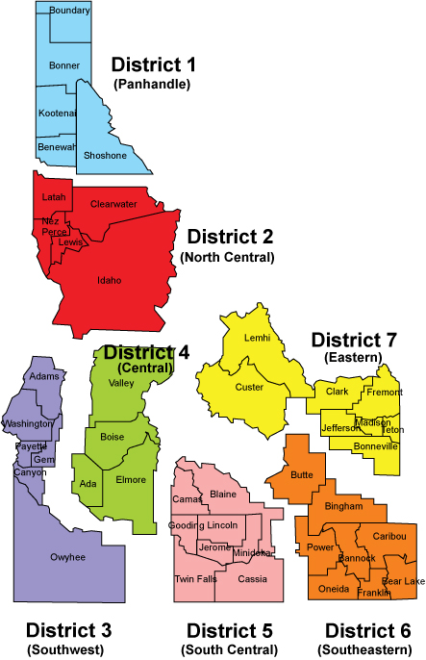
Idaho has seven local public health districts

Slide 3
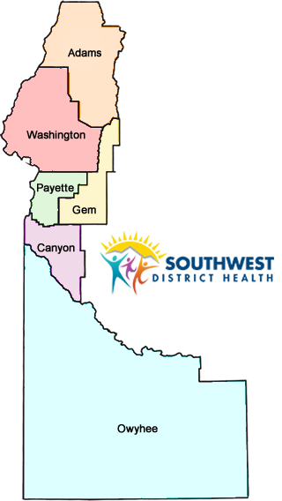
Facts about Southwest District Health
317,116 people in 2021
Canyon county alone consists for 231,105 people
Mostly rural
Jurisdiction is just over 12,000 mi²
Each county is considered medically underserved

Slide 4
There were two main problems this project addressed
Director wanted an estimate of COVID-19’s acute impact on health in our district
Some Board of Health members were concerned COVID-19 vaccine was killing people in our district

Slide 5
Solution thought process: measure of acute impact
Director wanted an estimate of COVID-19’s acute impact on health in our district
Thought through how, beyond direct deaths, COVID-19 might have impacted people’s health
Realized first step would be to see if there were more deaths than usual
Read literature on excess mortality

Slide 6
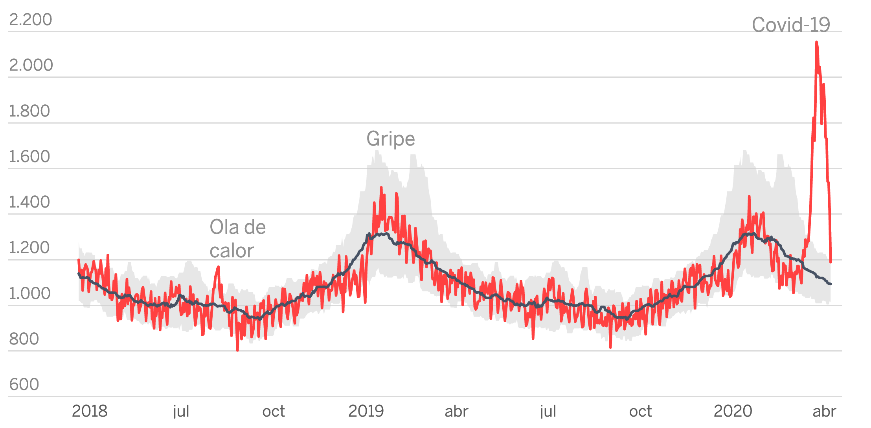
Solution thought process: measure of acute impact
Deaths
Date
Source: https://en.wikipedia.org/wiki/Excess_mortality

Slide 7
Solution thought process: vaccine concern
Some Board of Health members were concerned COVID-19 vaccine was killing people in our district
Instead of pulling studies, look at local data
Examine competing explanations: COVID-19 cases vs. COVID-19 vaccines
Correlate with death-rate from first solution
Show VAERS data compared with COVID and vaccine data

Slide 8
Data sources
Idaho Bureau of Vital Records and Health Statistics (death count)
Idaho’s Immunization Reminder Information System (mRNA vaccine count)
National Base System (COVID-19 cases count)
National Syndromic Surveillance Program (COVID-like illness ER visits)
Only covers Canyon, Payette, and Washington
Vaccine Adverse Event Reporting System (reported vaccine adverse reactions)
Federally provided; State-wide; Anyone can report any time

Slide 9
Data sources
Idaho Bureau of Vital Records and Health Statistics (death count)
Idaho’s Immunization Reminder Information System (mRNA vaccine count)
National Base System (COVID-19 cases count)
National Syndromic Surveillance Program (COVID-like illness ER visits)
Only covers Canyon, Payette, and Washington
Vaccine Adverse Event Reporting System (reported vaccine adverse reactions)
Federally provided; State-wide; Anyone can report any time

Slide 10

Model selection
$$y_{time}=β_{0}+β_{1}x_{time}+β_{2}x_{month}+ε_{time}$$
$$y_{time}=\frac{deaths}{population} x 100,000$$

Slide 11
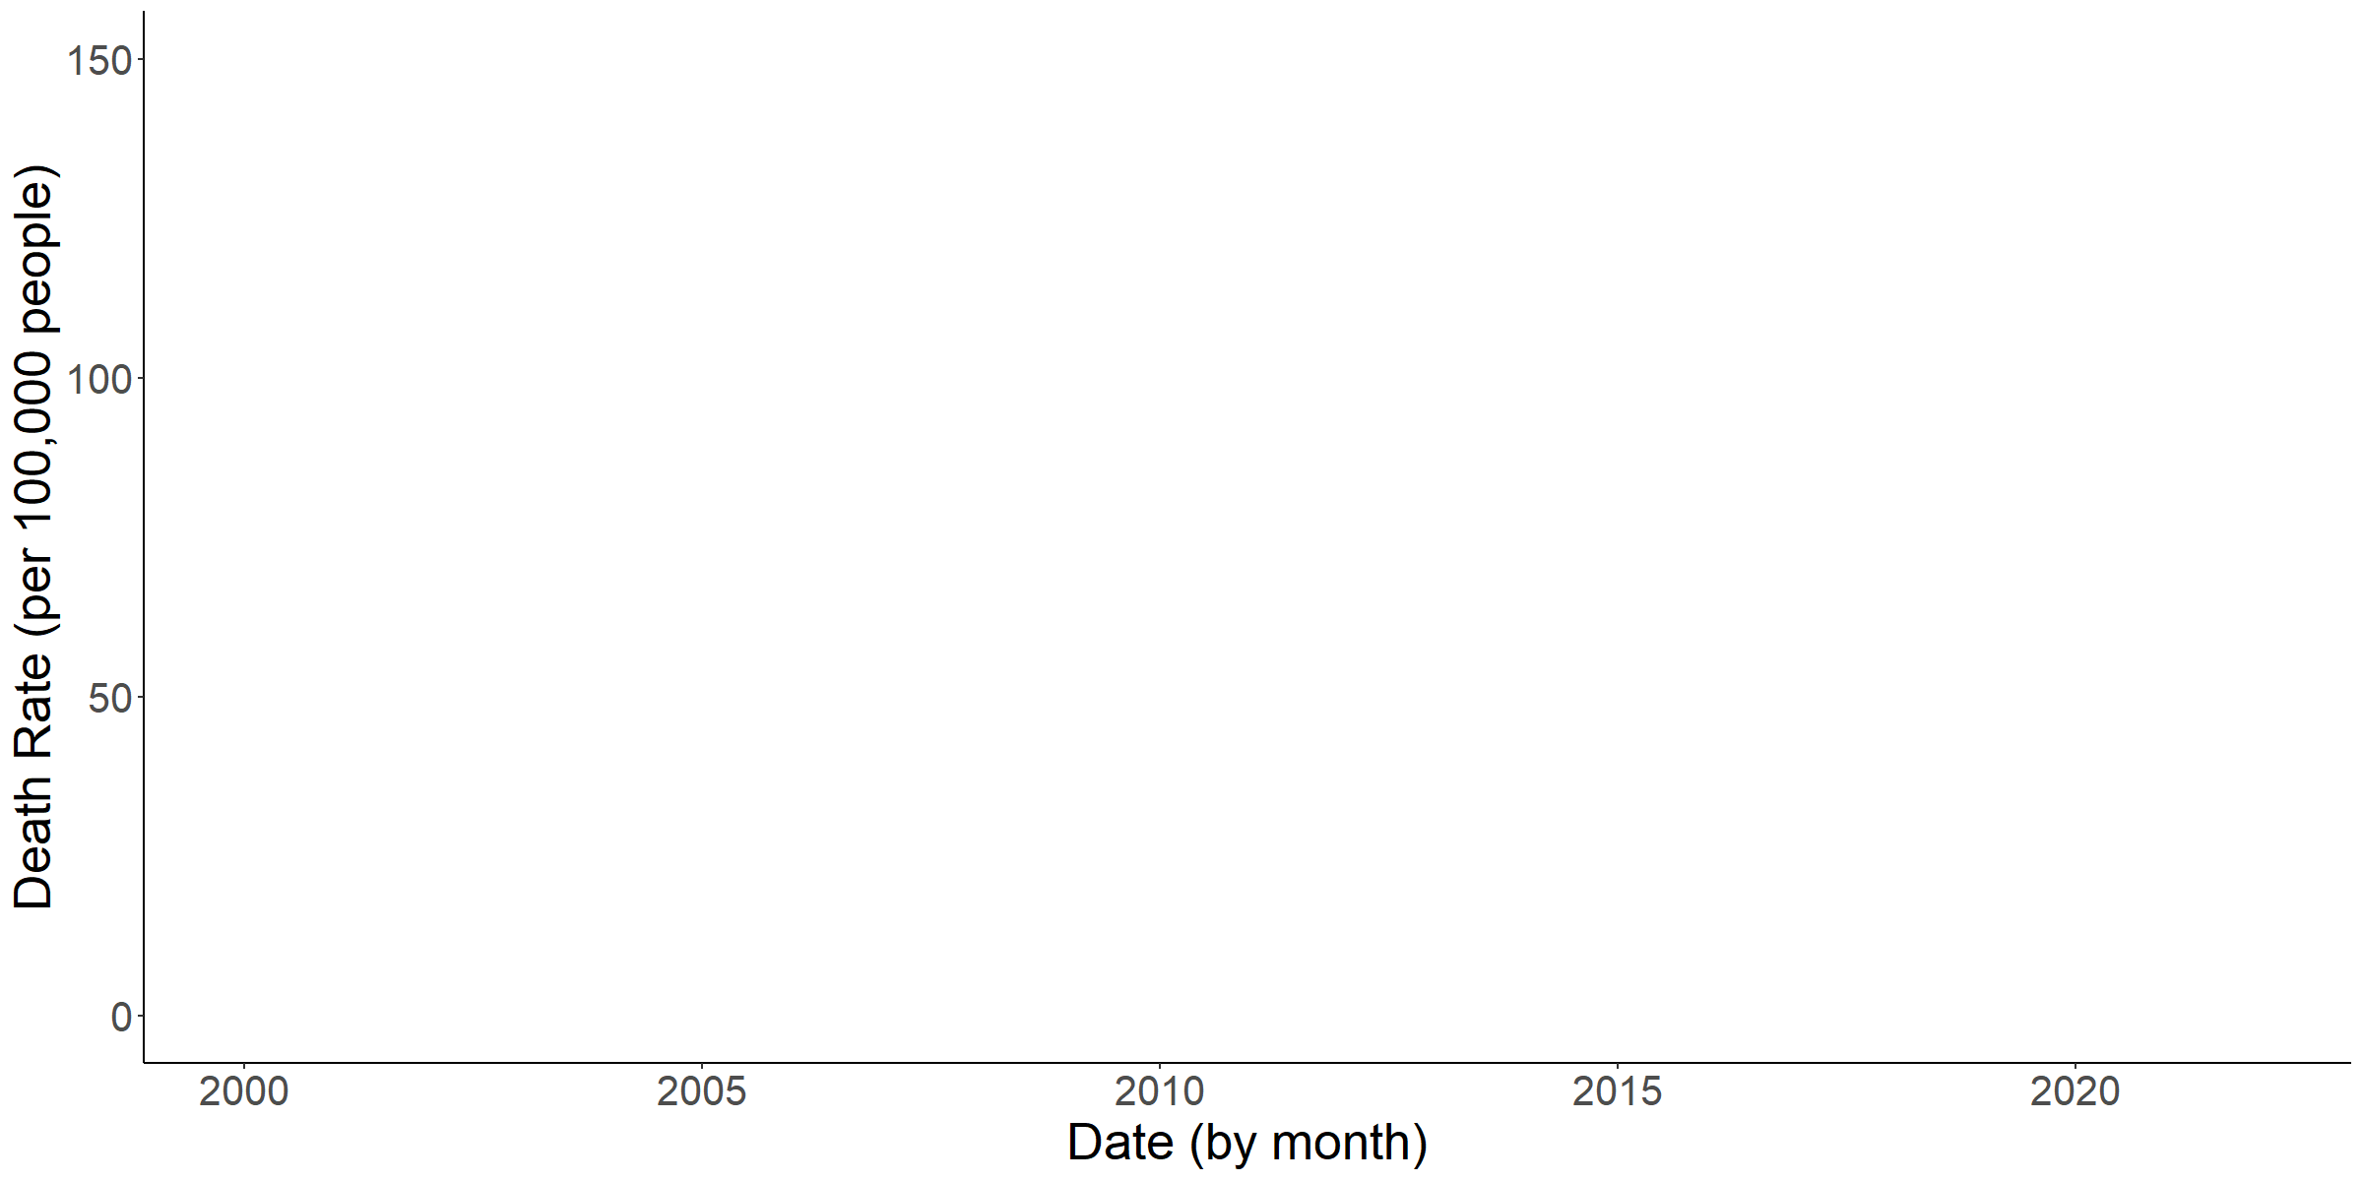
Monthly death rate in our jurisdiction (2000 Jan. to 2020 Feb.)
Source: https://en.wikipedia.org/wiki/Excess_mortality

Slide 12
Baseline model performance (2000 Jan. to 2020 Feb.)
$$R^{2}=0.195 ;Adjusted R^{2}=0.152$$

Slide 13
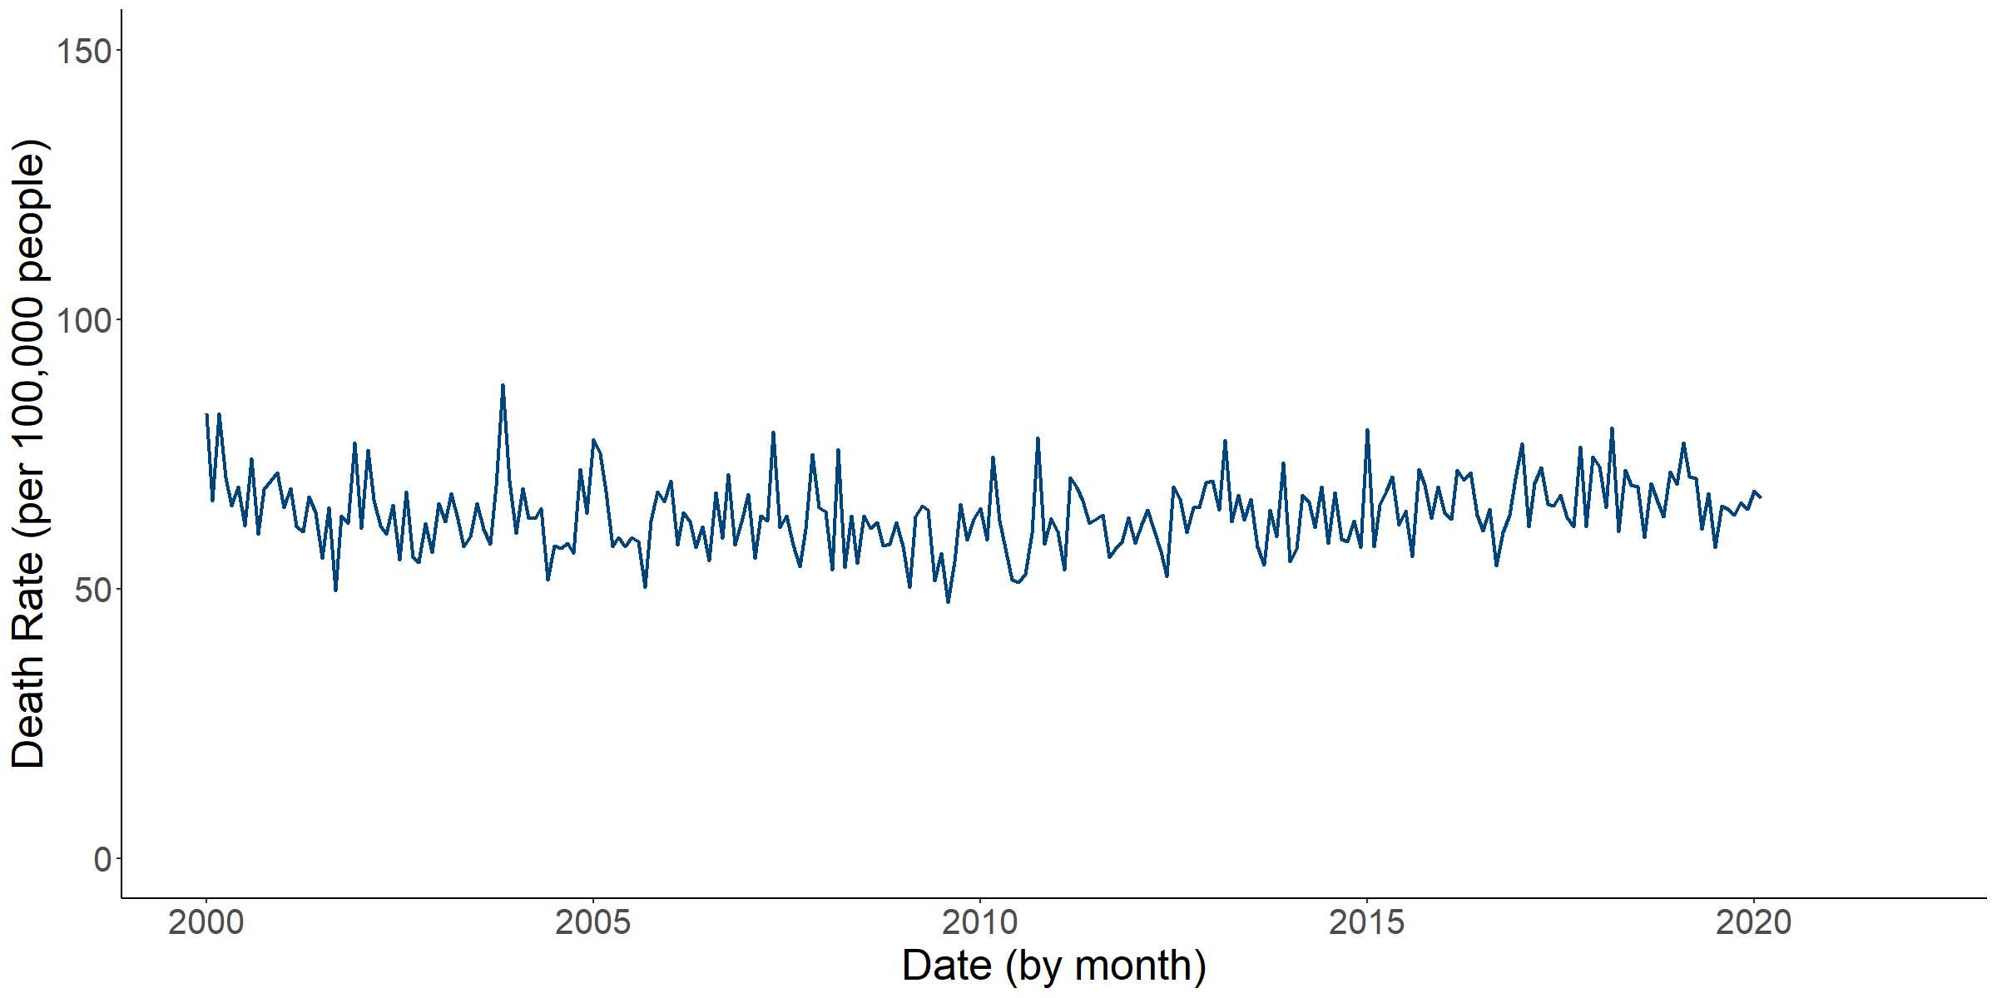
Forecasted death rate in our jurisdiction (2020 Mar. to 2021 Dec.)
Source: https://en.wikipedia.org/wiki/Excess_mortality

Slide 14
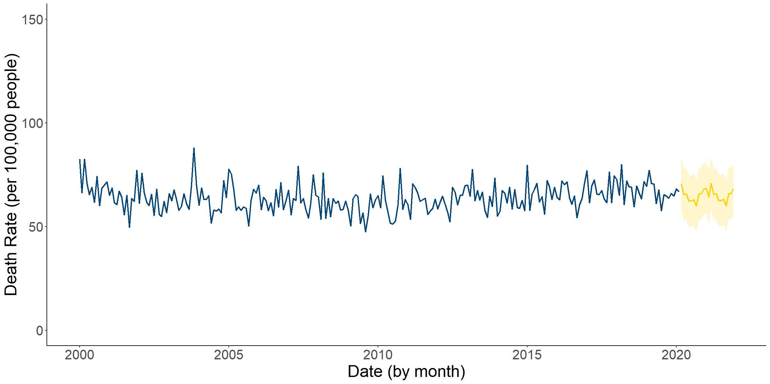
Actual death rate in our jurisdiction (2020 Mar. to 2021 Dec.)
Source: https://en.wikipedia.org/wiki/Excess_mortality

Slide 15
Estimated number of excess deaths (2020 Mar. to 2021 Dec.)
Estimated excess deaths: 1,067 (95% CI: 218 to 1,917)
Deaths directly due to COVID-19 recorded: 1,063
Estimated excess death rate per month: 15.63 (95% CI: 3.18 to 28.07)
About a year’s worth of suicides every month.

Slide 16

There were two main problems this project addressed
Director wanted an estimate of COVID-19’s acute impact on health in our district
Some Board of Health members were concerned COVID-19 vaccine was killing people in our district

Slide 17
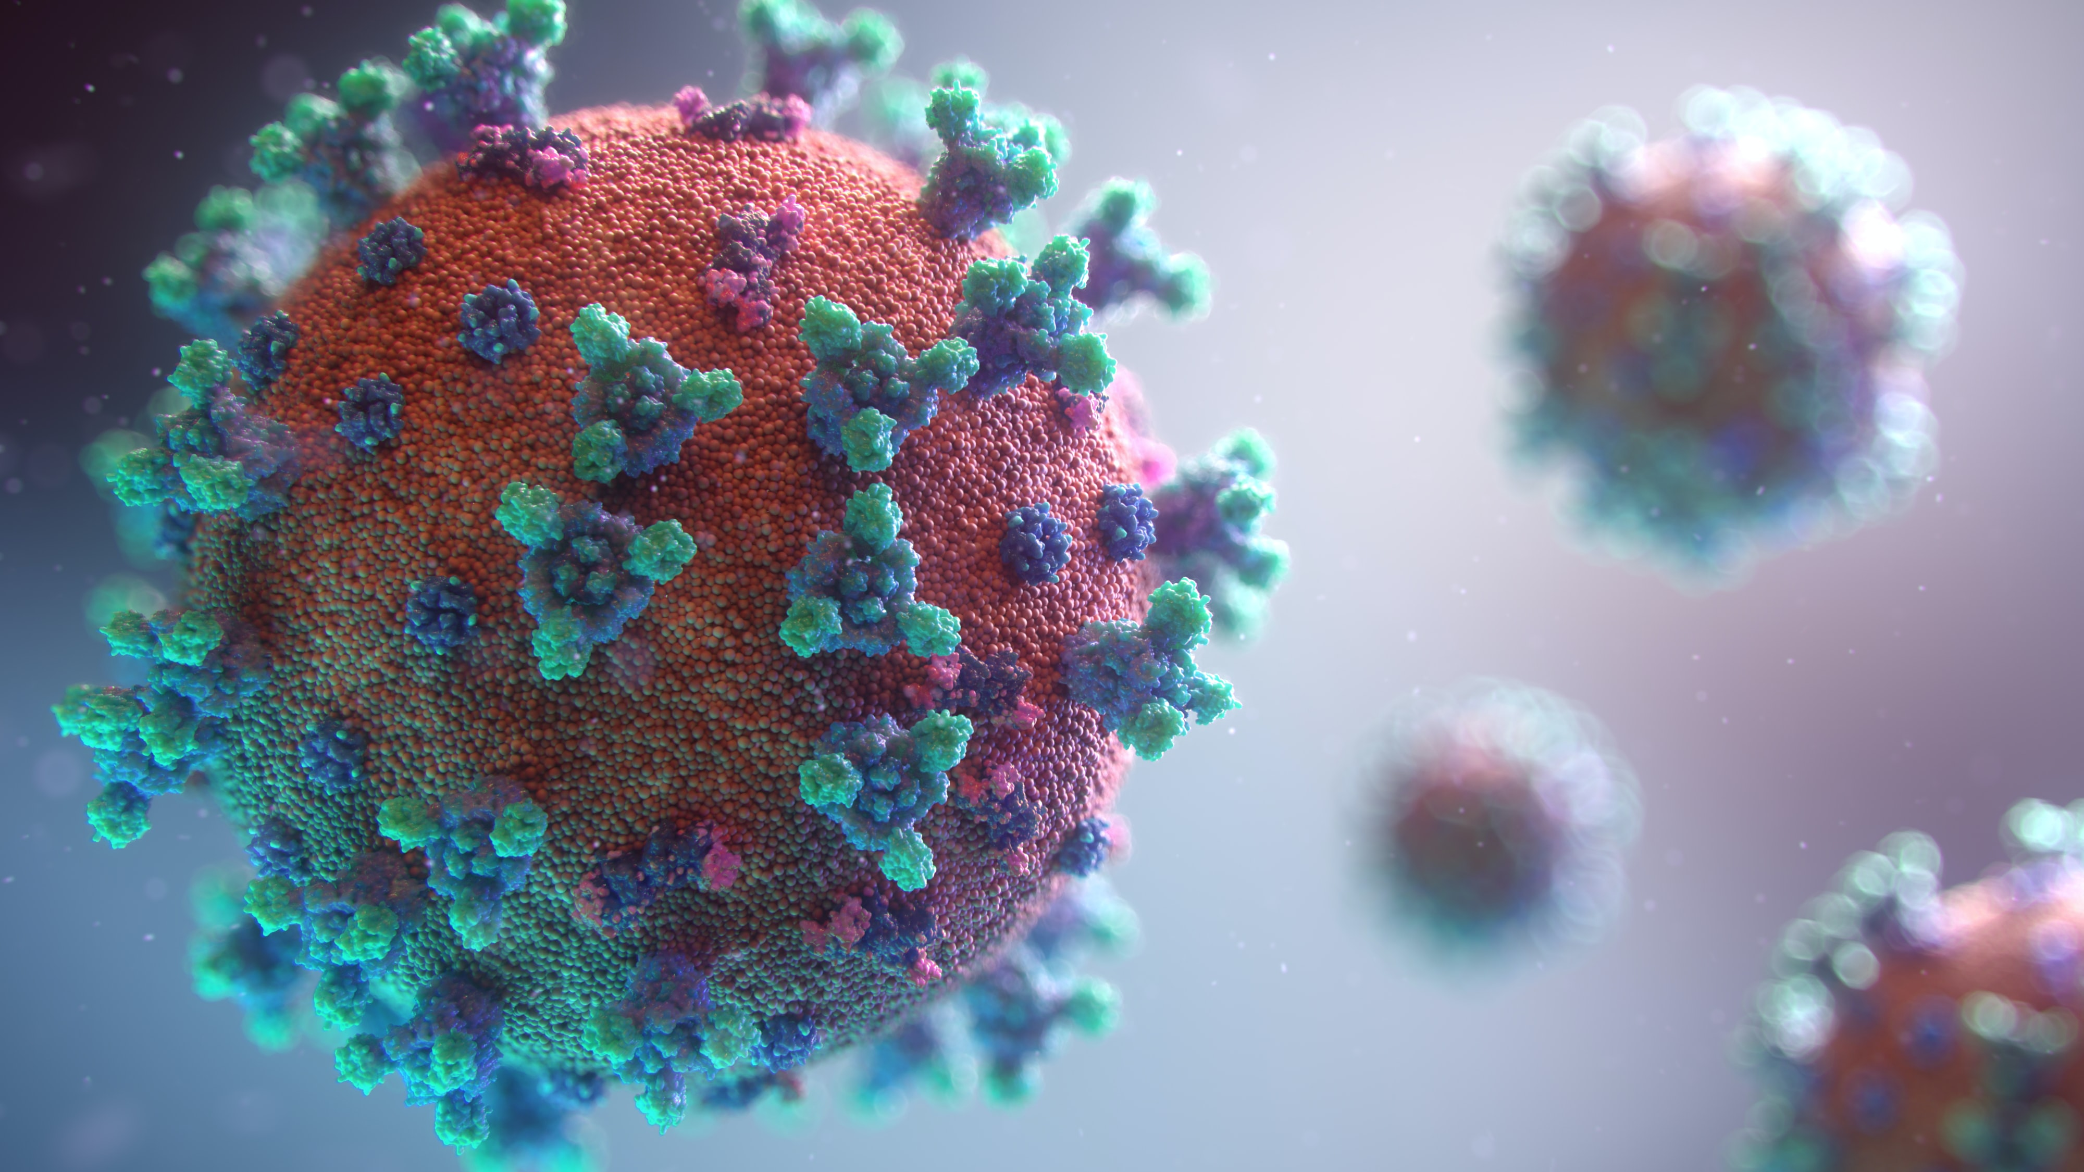
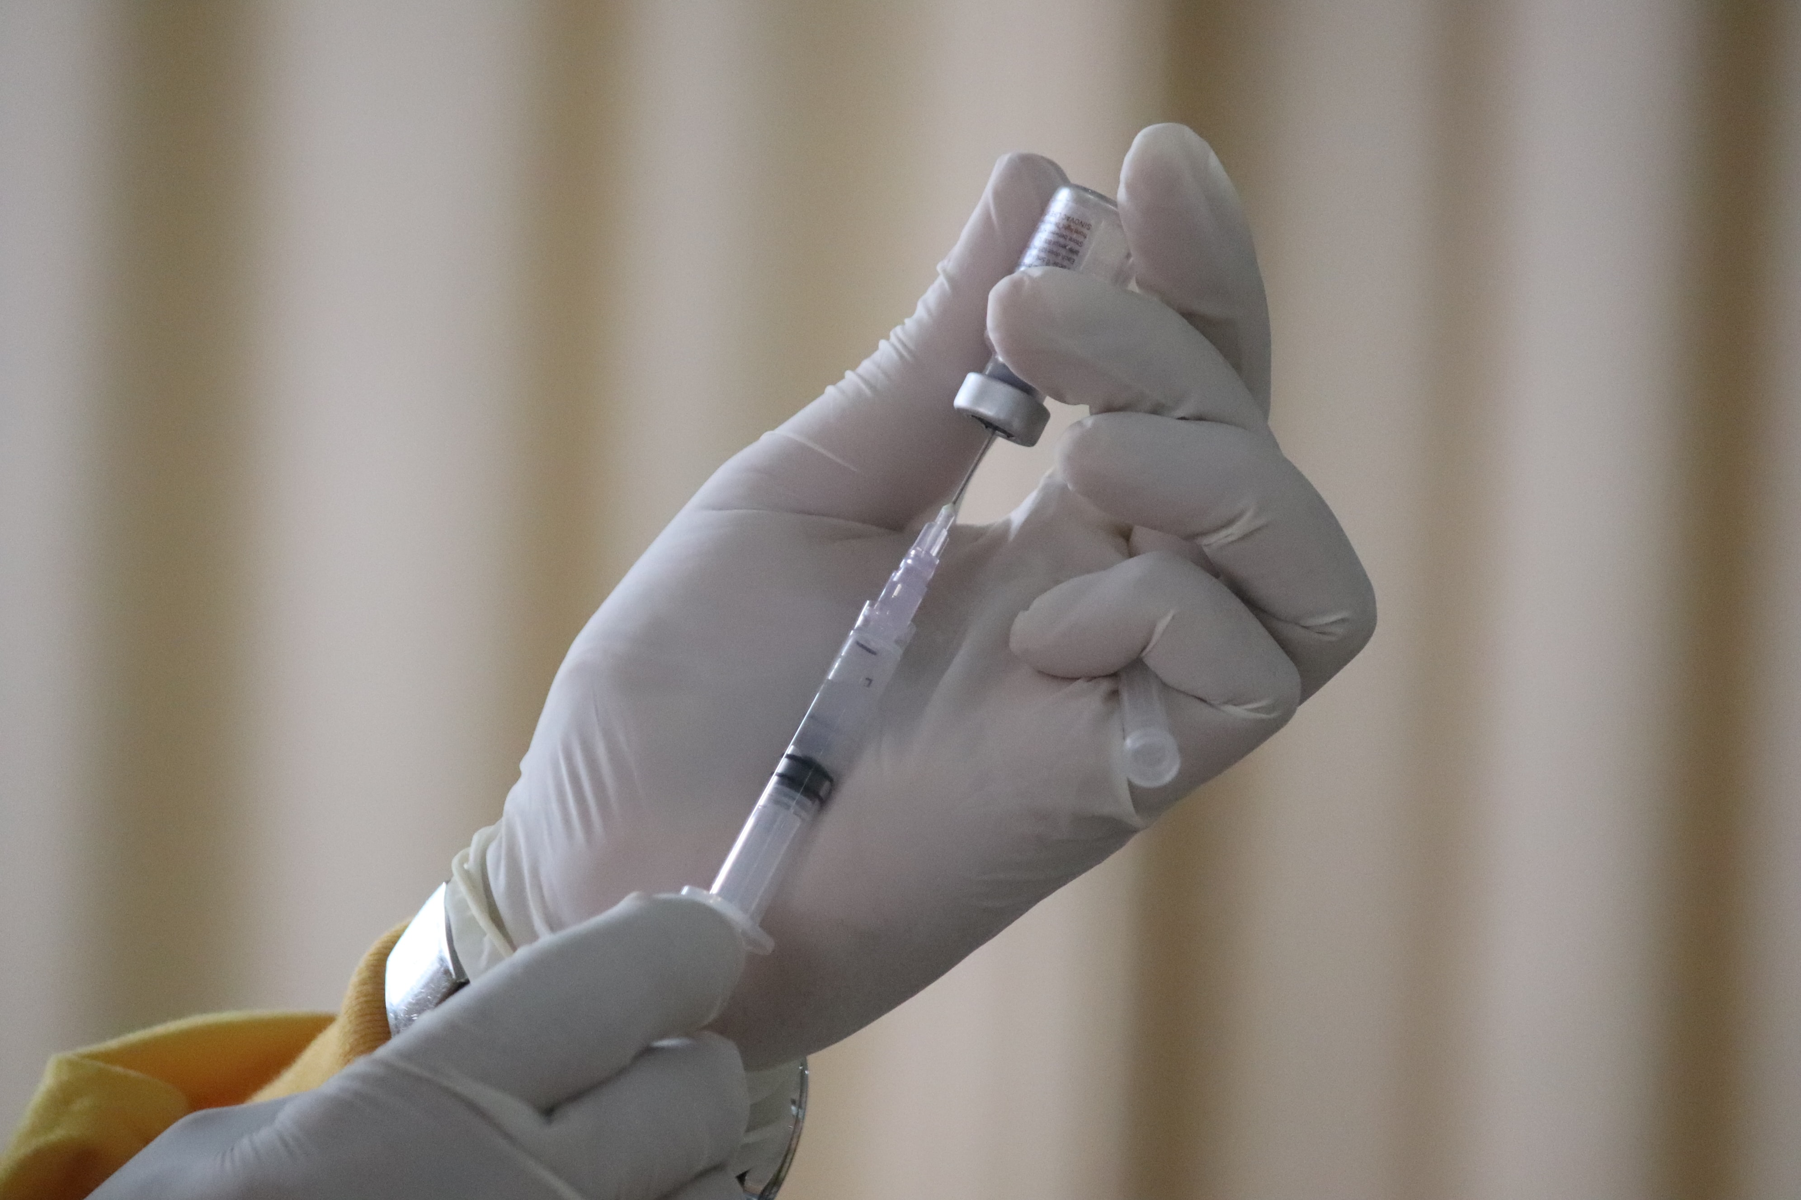
Correlates of death rate in our district
COVID-19 Cases Variables:
COVID-19 Vaccines Variables
COVID-19 cases
COVID-like illness ER Visits
mRNA (COVID) vaccines
Adverse event reports
Photo by Fusion Medical Animation on Unsplash
Photo by Mufid Majnun on Unsplash

Slide 18
Correlates of death rate in our district
COVID-19 Cases Variables:
COVID-19 Vaccines Variables
COVID-19 cases
COVID-like illness ER Visits
mRNA (COVID) vaccines
Adverse event reports
Photo by Fusion Medical Animation on Unsplash
Photo by Mufid Majnun on Unsplash

Slide 19
Model 1: COVID-19 cases & mRNA vaccines
COVID-19: b = 0.001, p = .013
Vaccines: b = -0.0002, p = .073
R² = 0.165; Adjusted R² = 0.118
Notes:
1000 cases ≈ ↑ 1 death rate ≈ 3 more deaths per month

Slide 20
Model 2: COVID-like illness ER visits & mRNA vaccines
CLI: b = 0.012, p = 6.69 X 10⁻⁵
Vaccines: b = -0.0003, p = .008
R² = 0.197; Adjusted R² = 0.152
Notes:
20000 vaccines ≈ decrease 6 death rate ≈ 18 fewer deaths per month

Slide 21
Model 3: COVID-19 cases & vaccine adverse event reports
COVID-19: b = 0.002, p =.006
AEs: b = -0.025, p = .019
R² = 0.173; Adjusted R² = 0.126
Notes:
250 Aes reported, decrease of about 6 in the death rate

Slide 22
Model 4: COVID-like illness ER Visits& vaccine adverse event reports
CLI: b = 0.011, p =6.03 X 10⁻⁵
AEs: b = -0.029, p = .005
R² = 0.201; Adjusted R² = 0.156
Notes:
700 CLI ER visits increase of about 8 in the death rate

Slide 23
Model 1: COVID-19 cases & mRNA vaccines
COVID-19: b = 0.001, p = .013
Vaccines: b = -0.0002, p = .073
R² = 0.165; Adjusted R² = 0.118
Notes:
1000 cases ≈ ↑ 1 death rate ≈ 3 more deaths per month

Slide 24
Model 1 assumptions are met
Notes:
20000 vaccines ≈ decrease 6 death rate ≈ 18 more deaths per month

Slide 25
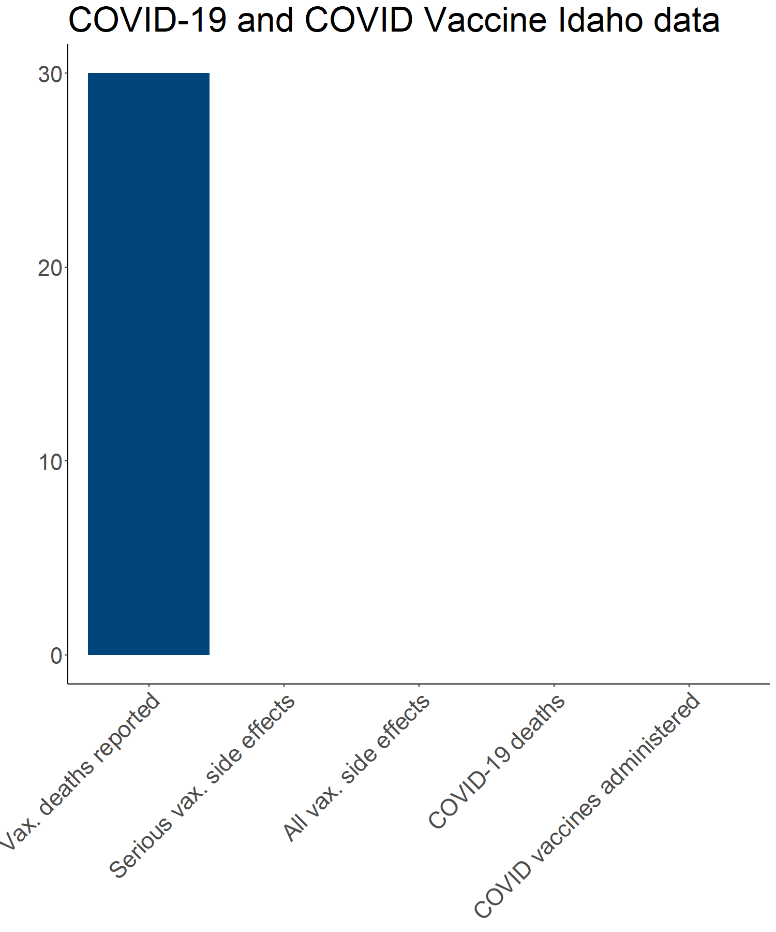
Idaho VAERS and COVID data
Notes:
20000 vaccines ≈ decrease 6 death rate ≈ 18 more deaths per month

Slide 26
There were two main problems this project addressed
Director wanted an estimate of COVID-19’s acute impact on health in our district
Some Board of Health members were concerned COVID-19 vaccine was killing people in our district

Slide 27
Takeaways
More people died in our district in 2020 and 2021 than would be expected based on last 20 years.
Point estimate aligns closely with confirmed deaths
More people getting COVID-19 = more deaths.
More people getting mRNA vaccines = fewer deaths.

Slide 28

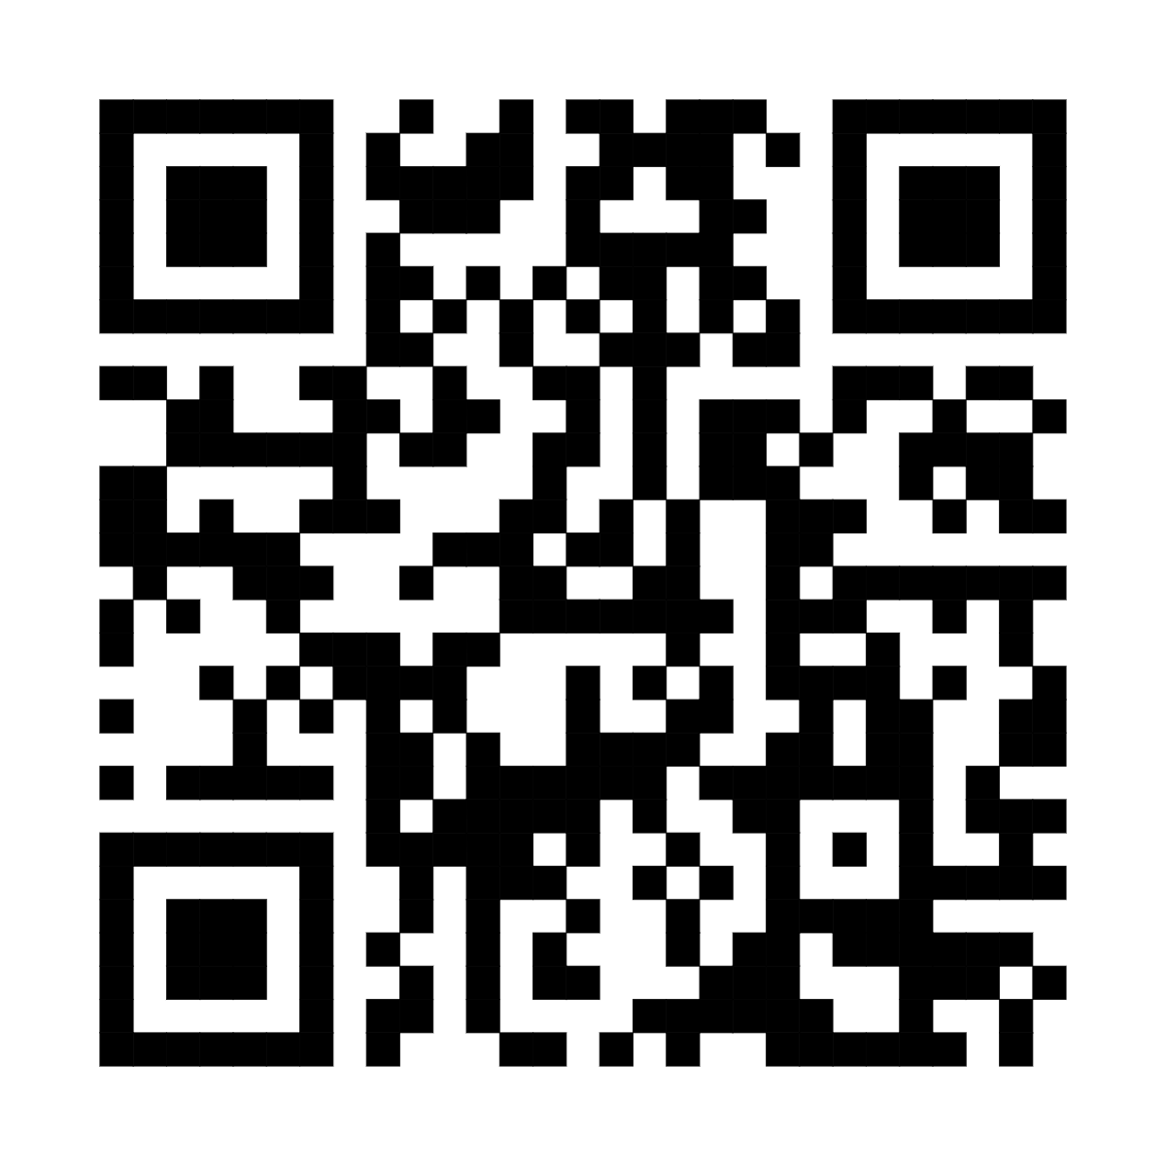
Questions?
Code available:
Photo by Camylla Battani on Unsplash

